Slide 1
4WD Robotic Arm-Based Dustbin Pickup and Garbage Disposal

Slide 2
01
Objectives of the project

Slide 3
Objectives
01
The objective of this project is to develop a 4-wheel-drive (4WD) robotic vehicle equipped with a Bluetooth-controlled robotic arm capable of picking up dustbins or garbage.
Equip the robot with a precise robotic arm to securely grasp and lift dustbins, facilitating efficient waste collection.
Enable wireless operation via Bluetooth, allowing users to control the robot remotely using a mobile application.
The robot can perform movements such as forward, backward, turning left, and turning right, while also allowing fine control of five servos for mechanical attachments (such as a robotic arm or gripper)

Slide 4
PROBLEM STATEMENT
Manual waste collection is often labor-intensive, unhygienic, and inefficient, especially in public spaces or hazardous areas.
There is a need for an automated, wireless system that can move independently.
Identify and collect waste using a robotic arm, and transport it for disposal, minimizing human involvement.
precision arm manipulation, and basic automation to improve cleanliness and reduce human effort.

Slide 5
Proposed Solutions
Solution 1
Solution 2
Develop a 4WD robotic vehicle equipped with a Bluetooth-controlled robotic arm that can pick up dustbins and dispose of garbage.
The robot will be capable of navigating via DC motors controlled by an L298N driver.
Solution 4
Solution 3
Offering safe and efficient waste collection without direct human contact.
The system will be remotely operated using a Bluetooth-enabled mobile device.

Slide 6
TECHNICAL SOLUTION
ESP32 is used for processing and Bluetooth communication.
4WD chassis with L298N motor driver to enable movement in all directions.
Robotic Arm 5-DOF arm using servo motors controlled via Adafruit PCA9685 PWM driver.
Bluetooth module (via ESP32) allows remote control through a mobile app or serial terminal.

Slide 7
IMPACT AND FEASIBILITY
IMPACT:
1. Reduces human involvement in unsanitary or hazardous environments.
2. Promotes hygiene and automation in waste management.
3. Increases efficiency and reliability of localized garbage disposal.
Feasibility:
1.Uses readily available and cost-effective components.
2. Modular design allows for scalability and upgrades.
3.Easily deployable in institutions, hospitals, residential societies, and urban areas

Slide 8
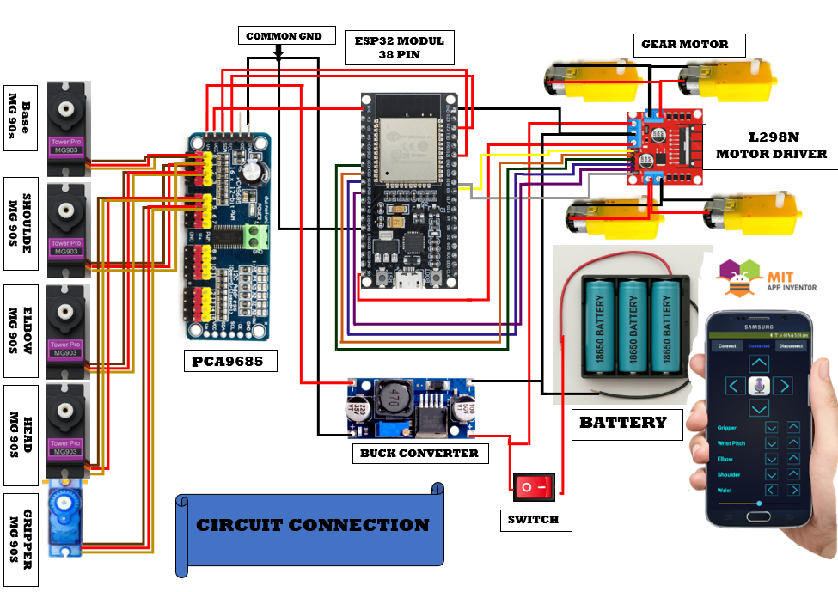
Working

Slide 9
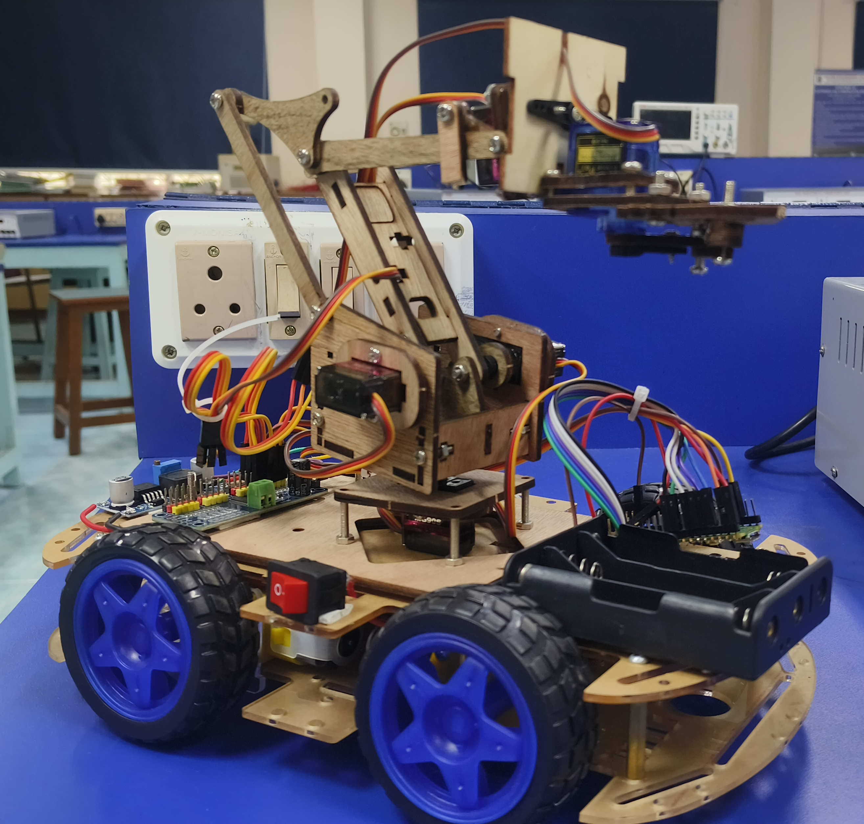
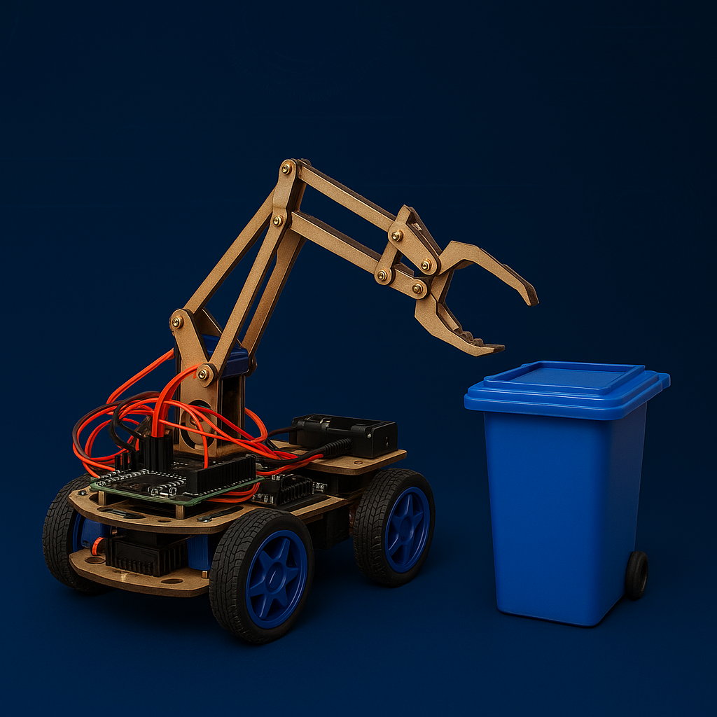
GRIPPER
HEAD
ELBOW
SHOULDER
BASE

Slide 10
01
Add image processing to identify trash or full bins.
02
Integrate ultrasonic or vision-based sensors for obstacle detection and path planning.
04
Add smart assistant integration for advanced control options.
05
Use Wi-Fi/MQTT for real-time data transmission and remote monitoring via a dashboard.

Slide 11
Thanks You !

